Slide 1
Alpha War
Kya Masoumi-Ravandi
Can Sozuer
Shihui Gao
Noof Al Shehhi
Danella Calina

Slide 2
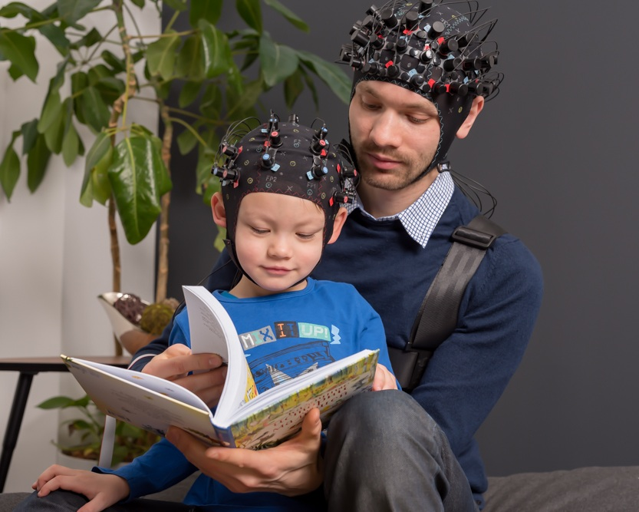

The Problem
Allow hyperscanning BCI to allow two people to play an EEG game together
Offering help for individuals with communication difficulties

Slide 3
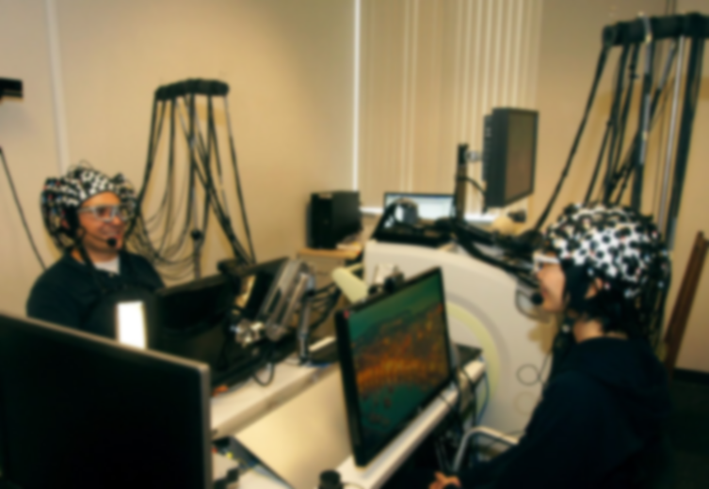

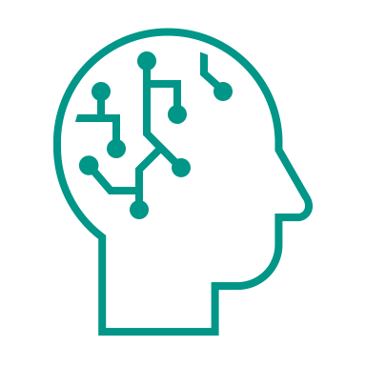
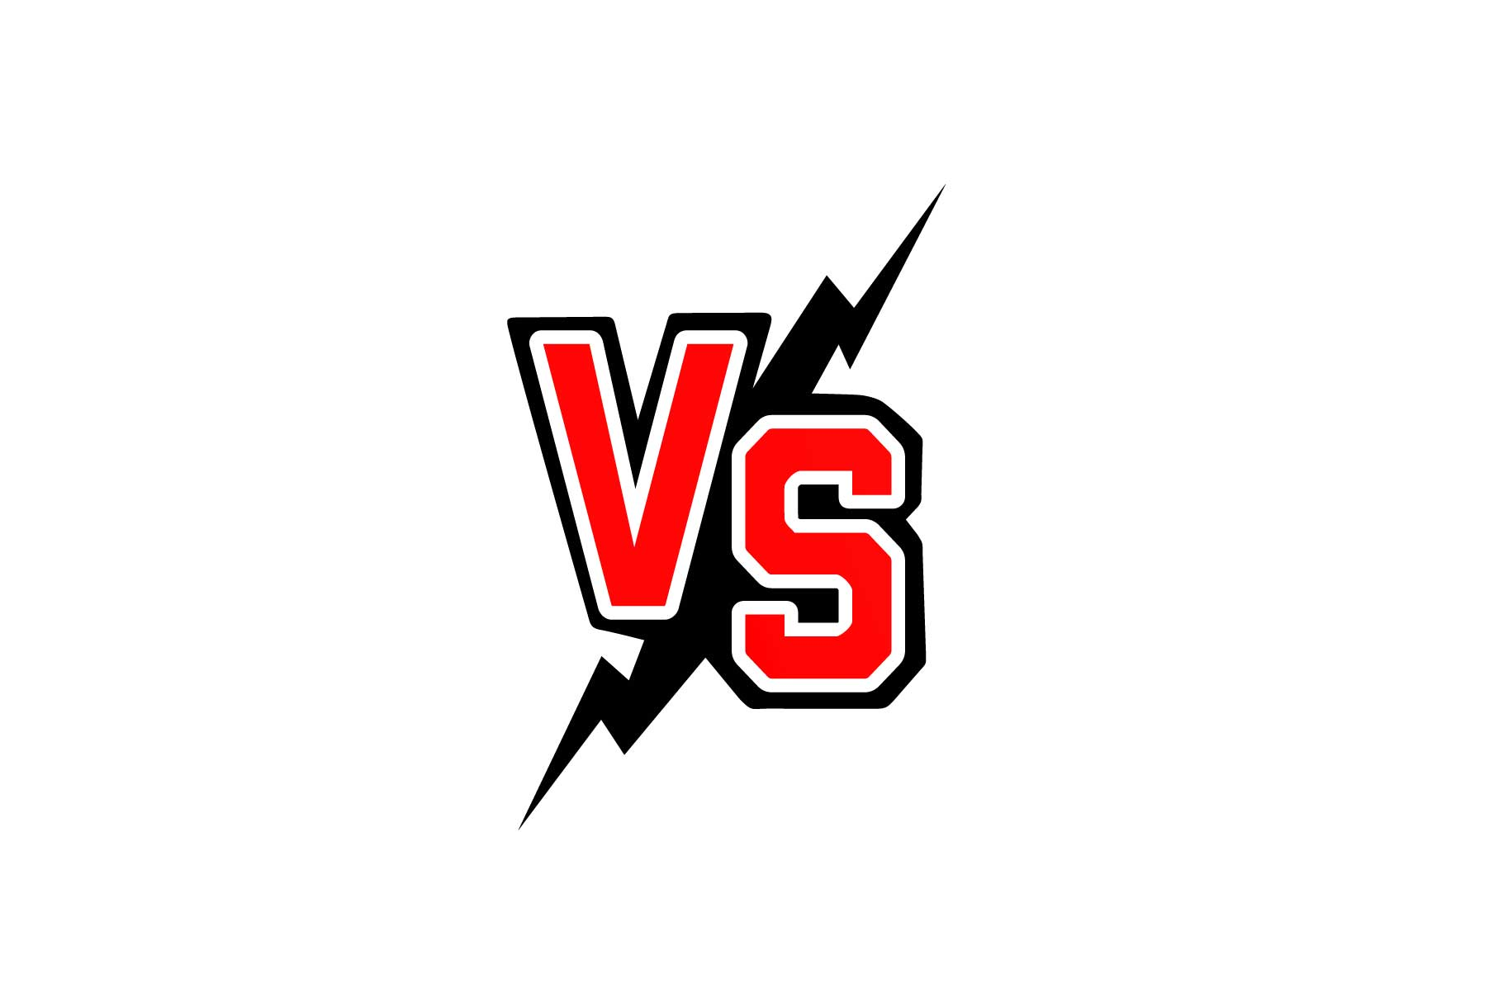

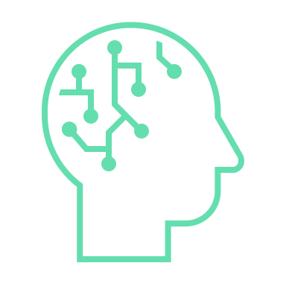


What is Alpha War

Slide 4
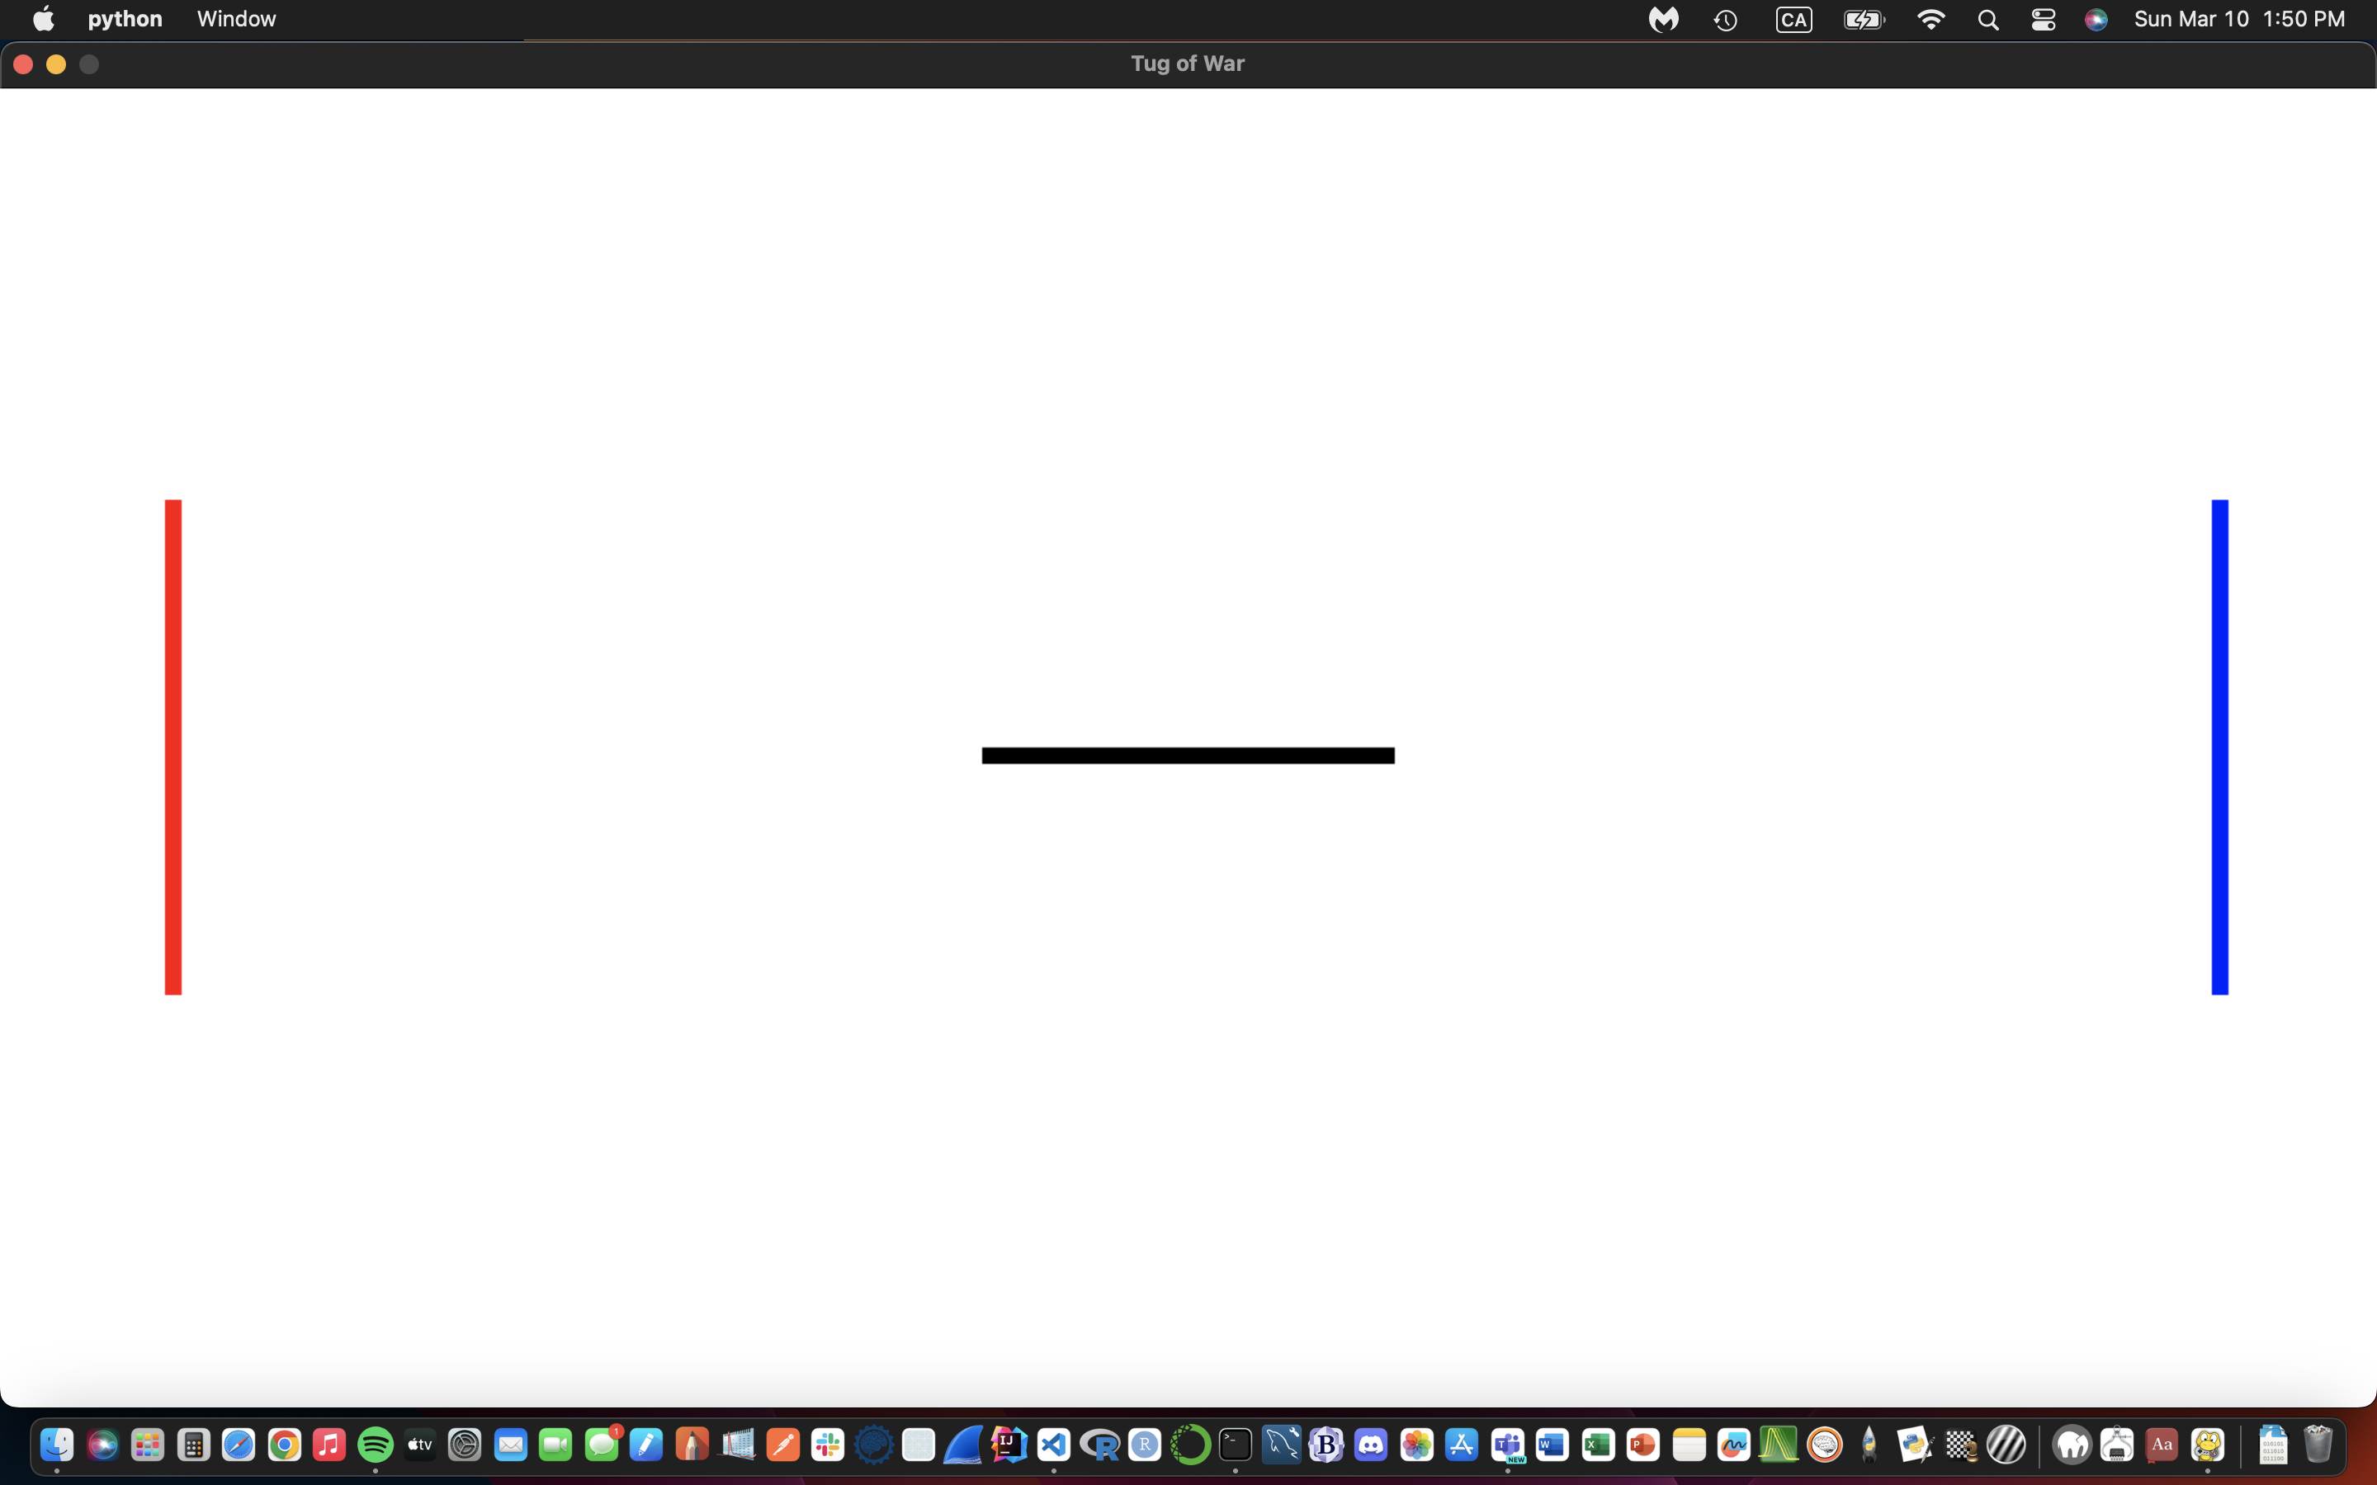
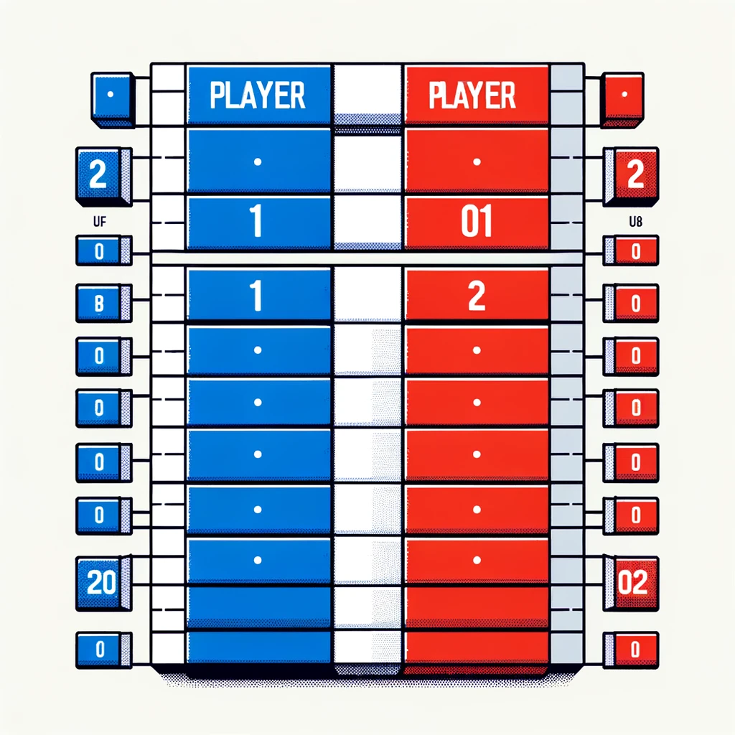
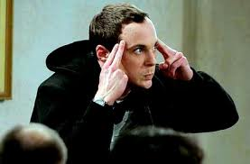

Slide 5
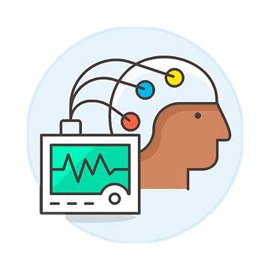
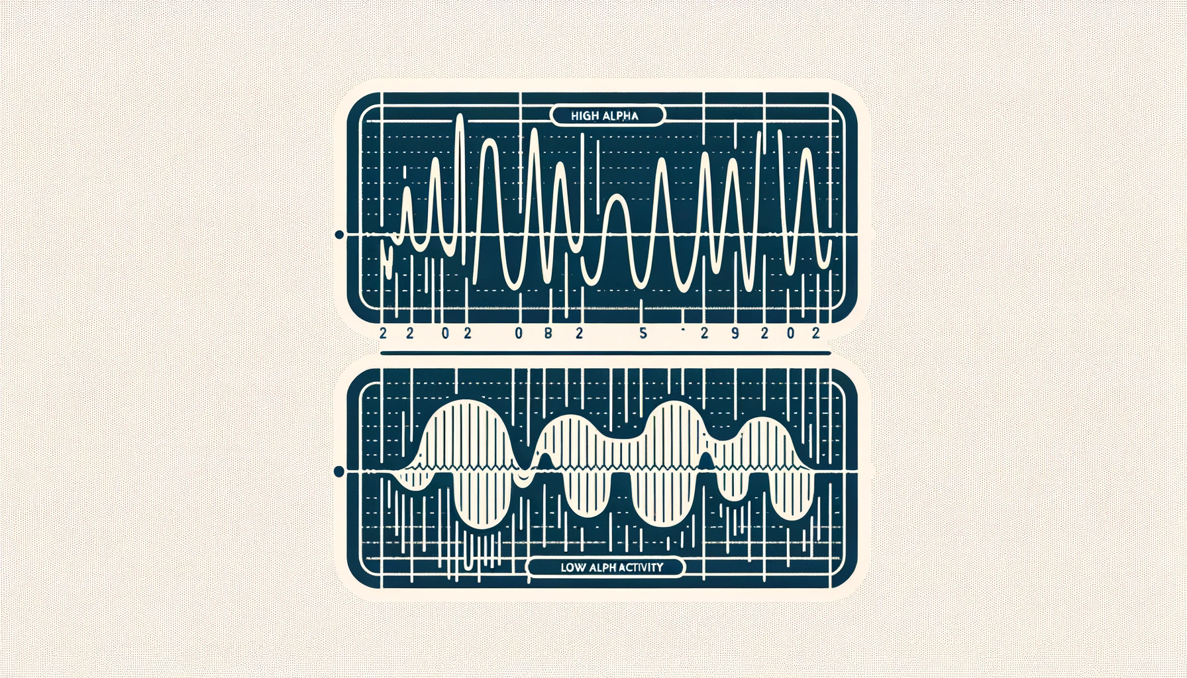
Algorithm
High
Win
Collect Alpha Waves
Collect Alpha Waves
Lose
Low

Slide 6
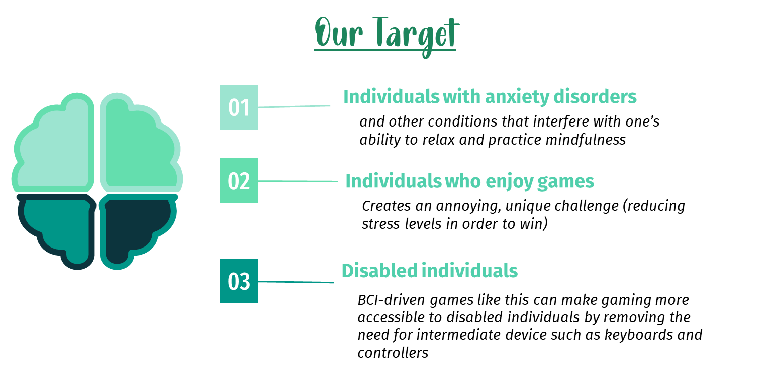

Slide 7
Benefits
Mercury
Attention and Cognitive Engagement
Planet Mercury is the closest object to the Sun
Emotional Regulation and Stress Reduction
Get better at paying attention, making decisions, and remembering things
Makes our brains release chemicals that make us feel good, like dopamine and serotonin
Mars
Despite being red, Mars is a cold place
Neurogenesis and the Brain
Jupiter
Our brains grow and get stronger, helping us learn new things and stay sharp as we grow older
Jupiter is a gas giant and the biggest planet

Slide 8
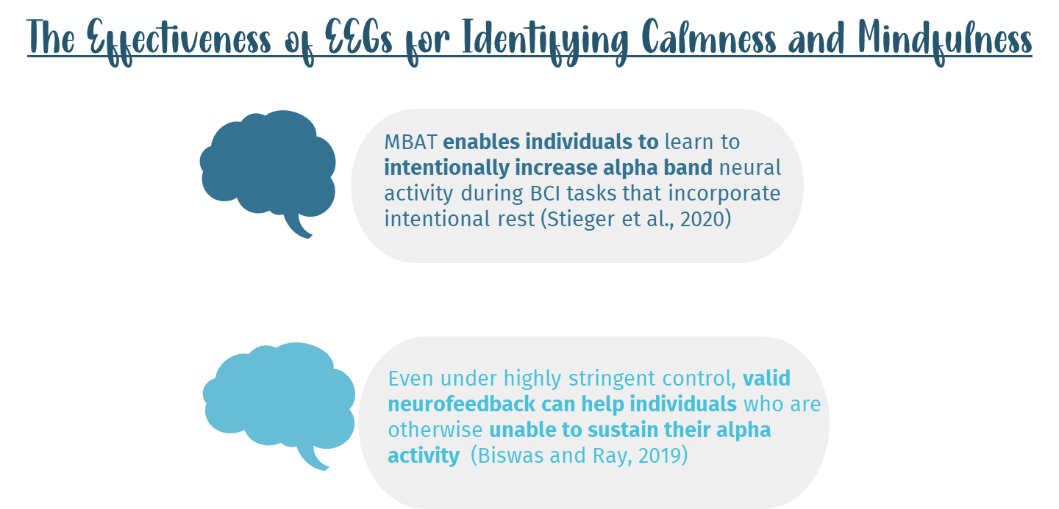

Slide 9
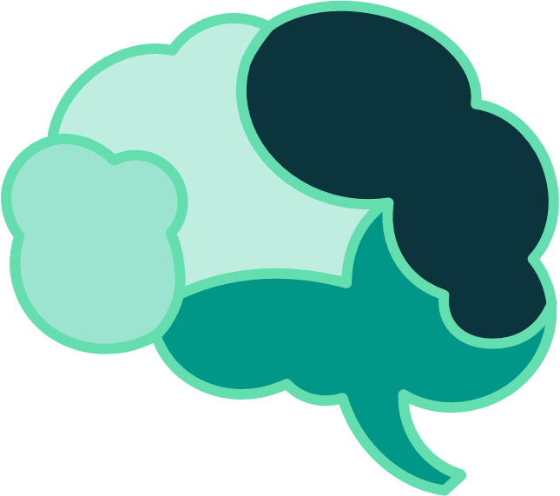
Citations
Stieger et al., (2020, September 23). Mindfulness Improves Brain–Computer Interface Performance by Increasing Control Over Neural Activity in the Alpha Band. National Library of Medicine. https://www.ncbi.nlm.nih.gov/pmc/articles/PMC7727383/
Biswas, A., & Ray, S. (2019, August 22). Alpha Neurofeedback Has a Positive Effect for Participants Who Are Unable to Sustain Their Alpha Activity. National Library of Medicine. https://www.ncbi.nlm.nih.gov/pmc/articles/PMC6709230/

